Slide 1

gen Z Solutions
www.genzsoln.com
Consulting | Solutions | Outsourcing
API Manual Testing POC
Name: Arun Angadi

Slide 2
Scope of POC
The scope of a manual API testing can vary depending on the specific requirements and objectives of the project. However, I'll outline a general scope for a manual API testing POC to help you get started.
Objective: The main objective of the manual API testing POC is to gain confidence in the API's
functionality, reliability, and performance. It allows you to verify that the API works as expected, handles different inputs and returns accurate responses.

Slide 3
Purpose of POC
API manual testing serves several important purposes:
Understanding API Functionality
Validating API Documentation
Identifying Bugs and Issues
Testing Edge Cases
Usability and User Experience
Quick Feedback and Iterative Improvements
Understanding API Security
Compatibility Testing
Gaining Confidence
Status code
Headers
Cookies
Response Timing
Response body

Slide 4
Tools/Software/Application used in POC
# | Tool/SW/Application | Brief Description | From Where to Download | What is the Use in POC?
1. | Postman | Postman is an API(application programming interface) development tool. which helps to build, test and modify APIs. Almost any functionality that could be needed by any developer is encapsulated in this tool. | POSTMAN | The Postman is enables you to easily explore, debug, and test your APIs while also enabling you to define complex API requests for HTTP, REST, SOAP, GraphQL, and Web Sockets.

Slide 5
Tools/Software/Application used in POC
# | Tool/SW/Application | Brief Description | From Where to Download | What is the Use in POC?
2. | JSONPATH | JSONPath is a query language for JSON, similar to Path for XML. | JSONPATH | It allows you to select and extract data from a JSON document. You use a JSONPath expression to traverse the path to an element in the JSON structure.
3 | JSON Path Finder | Helps to find JSONPaths in a JSON document. | JSON Path Finder | View object tree, identify the different input expressions and extract the matching piece of JSON data against the input expression.

Slide 6
Tools/Software/Application used in POC
# | Tool/SW/Application | Brief Description | From Where to Download | What is the Use in POC?
4. | JSON (JavaScript Object Notation) Schema | JSON Schema is a specification used to define the structure and constraints of JSON data. | JSON Schema | It provides a way to validate and describe the format of JSON documents, ensuring they adhere to specific rules and requirements. JSON Schema is especially useful when you need to define the expected data format for APIs, data exchange, and configuration files.

Slide 7
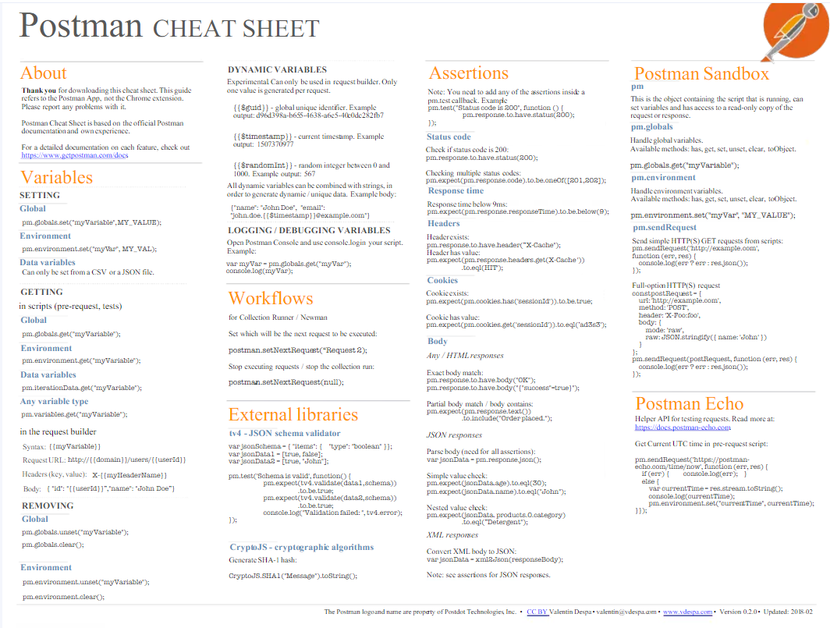
POSTMAN CHEAT SHEET

Slide 8
Use Cases/Test Scenarios
Create Student Record:
Test creating a new student record with valid data (name, age, address, etc.).
Test creating a student record with missing or incomplete data and verify appropriate error handling.
Verify that the API returns a unique identifier (ID) for each created student record.
Verify that the API enforces data validation rules (e.g., age should be a positive integer).
Read Student Record:
Test retrieving a student record by its unique ID.
Test retrieving a list of all student records and verify the response contains the expected number of records.
Verify the API's response when trying to retrieve a non-existent student record.

Slide 9
Use Cases/Test Scenarios
​Update Student Record:
Test updating an existing student record with valid data.
Test updating a student record with missing or incorrect data and verify appropriate error handling.
Verify that the API enforces validation rules during updates (e.g., age should not be negative).
Delete Student Record:​
Test deleting an existing student record by its unique ID.​
Verify the API's response when trying to delete a non-existent student record.​
Test the API's behavior after a successful deletion (e.g., ensuring the record is no longer accessible).​

Slide 10
API Testing Framework Explained
Open Postman Tool.
Create Collection and Folder and name them.
Create HTTP Requests.
Save requests and click send button.

Slide 11
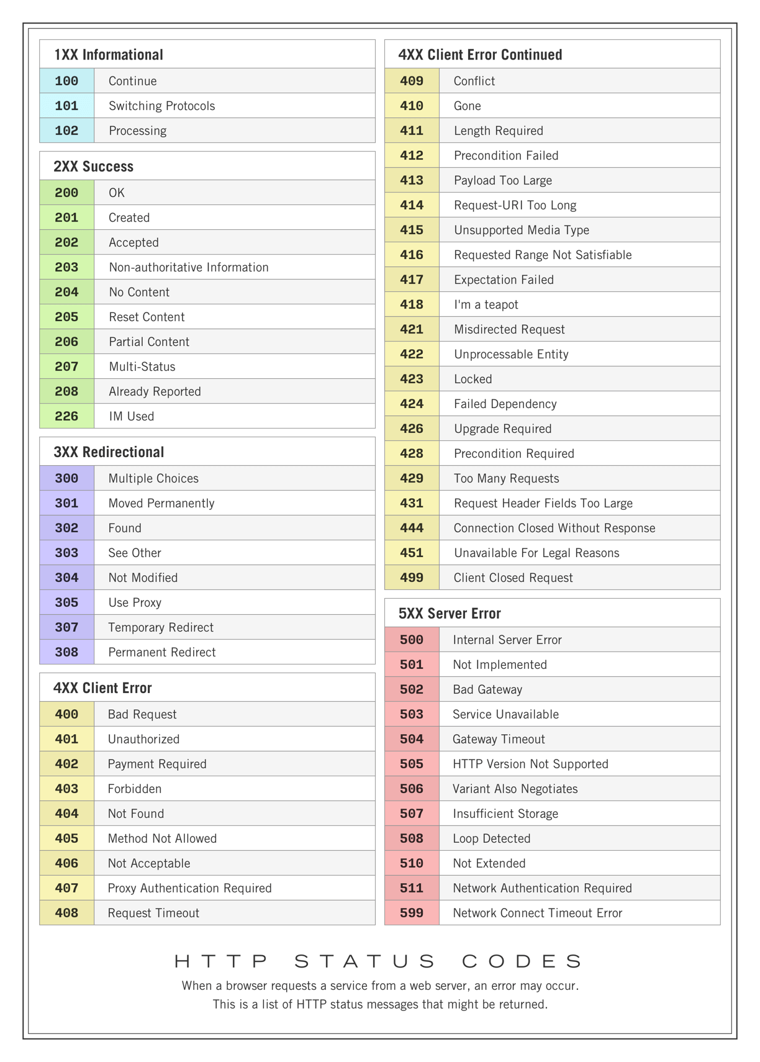
Reporting Framework Explained

Slide 12
Common Functions Developed
GET: http://localhost:3000/student/
​
POST: http://localhost:3000/student​/
​
PUT: http://localhost:3000/student/5​
​
DELETE: http://localhost:3000/student/5​

Slide 13
Code Walk Through – Explain the Framework.
GET :
pm.test("Status code is 200", () => {
pm.response.to.have.status(200);
});
pm.test("Content-type header is present", () => {
pm.response.to.have.header("Content-Type");
});
pm.test("Content-Type header is applications/json", () =>{
pm.expect(pm.response.headers.get('Content-Type')).to.eql
('application/json; charset=utf-8');
})

Slide 14
Code Walk Through – Explain the Framework.
pm.test("Cookie 'language' is present", () => {
pm.expect(pm.cookies.has('language')).to.be.true;
});
pm.test("Cookies language has value 1", () => {
pm.expect(pm.cookies.get('language')).to.eql('en-gb')
});
pm.test("Response is less then 50ms", () => {
pm.expect(pm.response.responseTime).to.be.below(50);
});

Slide 15
Code Walk Through – Explain the Framework.
//test array have correct datatypes
const jsonData = pm.response.json();
pm.test("Test data type of the response", () => {
pm.expect(jsonData).to.be.an("object");
pm.expect(jsonData.name).to.be.a("string");
pm.expect(jsonData.location).to.be.a("string");
pm.expect(jsonData.phone).to.be.a("string");
pm.expect(jsonData.id).to.be.an("number");
pm.expect(jsonData.courses).to.be.an("array");
});
//test array contents in body
pm.test("Test array properties", () =>{
//pm.expect(jsonData.courses).to.include("API");
pm.expect(jsonData.courses).to.have.members(["API", "Maven"]);
});

Slide 16
Code Walk Through – Explain the Framework.
//Validating JSON fields in Response
pm.test("values of all fields in Response", () => {
pm.expect(jsonData.id).to.eql(4);
pm.expect(jsonData.name).to.eql("Pawan");
pm.expect(jsonData.location).to.eql("Hydrabad");
pm.expect(jsonData.phone).to.eql("123456098");
pm.expect(jsonData.courses[0]).to.eql("API");
pm.expect(jsonData.courses[1]).to.eql("Maven");
});

Slide 17
Code Walk Through – Explain the Framework.
var schema={
"$schema": "http://json-schema.org/draft-06/schema#",
"$ref": "#/definitions/Welcome8",
"definitions": {
"Welcome8": {
"type": "object",
"additionalProperties": true,
"properties": {
"id": {
"type": "integer"
},
"name": {
"type": "string"
},

Slide 18
Code Walk Through – Explain the Framework.
"location": {
"type": "string"
},
"phone": {
"type": "string",
"format": "integer"
},
"courses": {
"type": "array",
"items": {
"type": "string"
}
}
},

Slide 19
Code Walk Through – Explain the Framework.
"required": [
"courses",
"id",
"location",
"name",
"phone"
],
}
}
}
pm.test("Schema is valid", () =>{
pm.expect(tv4.validate(jsonData, schema)).to.be.true;
});

Slide 20
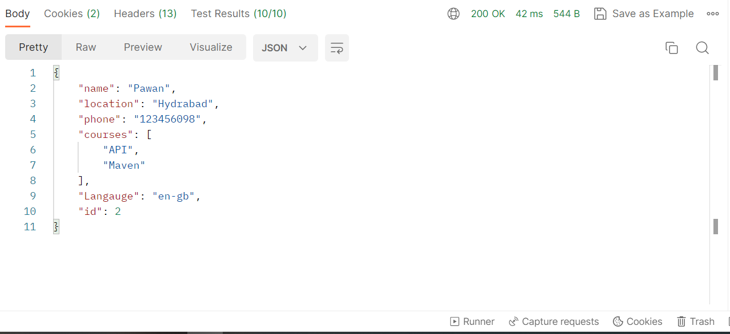
Test Report

Slide 21
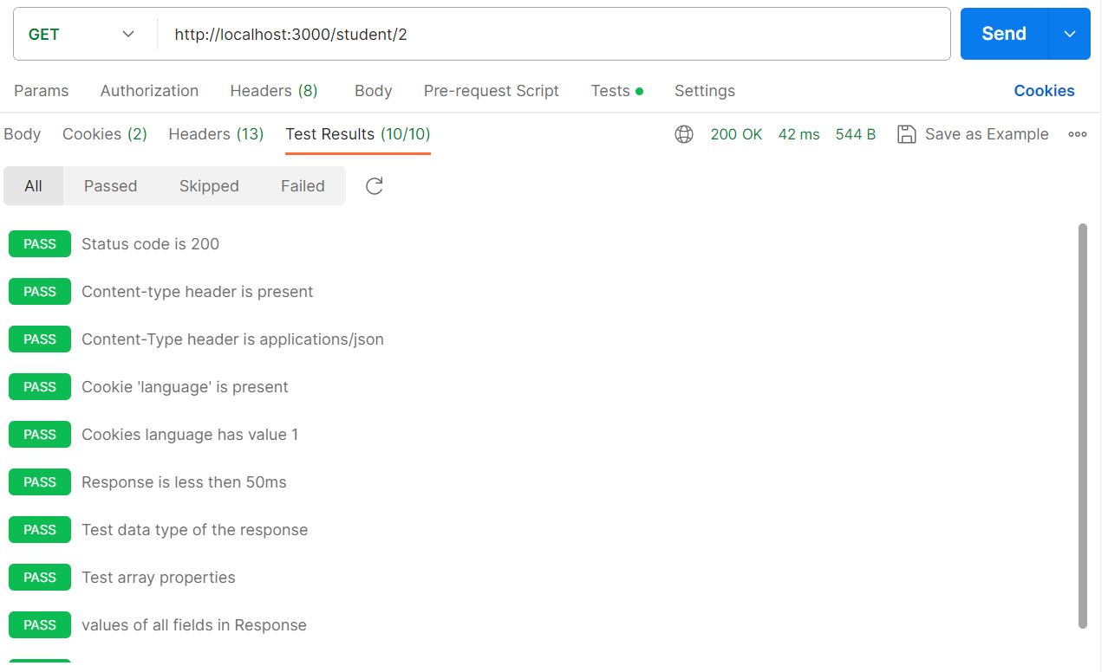
Test Report

Slide 22
Learnings of POC
How to do API testing through Postman tool.
Types of HTTPS requests (Get, Put, Post, Delete etc.).
Validate request and response data and data types.
How to connect two applications together.

Slide 23
Next Steps
Create Variables and Scripts.
Test on Automation tools.

